Slide 1
Lecture 10 Data Visualization
ITP4869 Analysis with Programming Tools
(AY 2018/19)
Dr. Johnny Cheng

Slide 2
Lessons Intended Learning Outcomes
On completion of this lesson, students are expected to be able to:
Identify the basic concepts of data visualization;
Create basic plots with matplotlib Library;
Refine basic plots with line properties, multiple figures, and annotated text; and
Draw basic 3D plots with mpl_toolkits (Optional).

Slide 3
Data Visualization
Visualizing Data with matplotlib

Slide 4
Visualizing Data with matplotlib
Visualization is one of the first steps in data analysis.
Data visualization calls for the conception and analysis of the visual representation of information.
There are two primary uses for data visualization:
To explore data
To communicate data
The Python matplotlib library is a well-known plotting library based on NumPy.
You need to include the import statement before running the scripts illustrated throughout this lesson:
>>> from matplotlib import pyplot as plt OR
>>> import matplotlib.pyplot as plt

Slide 5
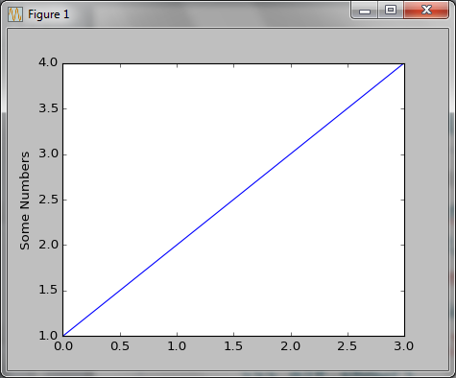
Visualizing Data with matplotlib (cont.)
Let’s get started with matplotlib by a simple example:
>>> import matplotlib.pyplot as plt
>>> plt.plot([1,2,3,4])
[<matplotlib.lines.Line2D object at 0x046B2490>]
>>> plt.ylabel('Some Numbers')
<matplotlib.text.Text object at 0x0456E090>
>>> plt.show()

Slide 6
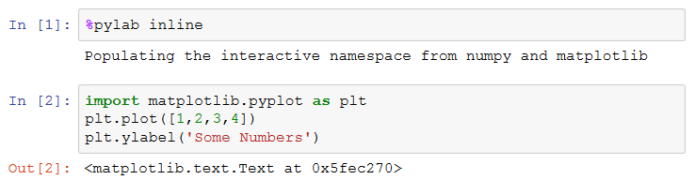
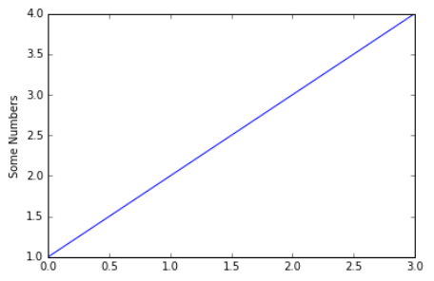
Visualizing Data with matplotlib (cont.)
If you use IPython, the task becomes more simple:
The %pylab magic command allows us to have figures plotted inline, without including plt.show().

Slide 7
2D Plots
Plotting Figure by Points
Plotting Figure by Standard Functions
Customizing the Plot
Working with Multiple Figures
Working with Other 2D Figures

Slide 8
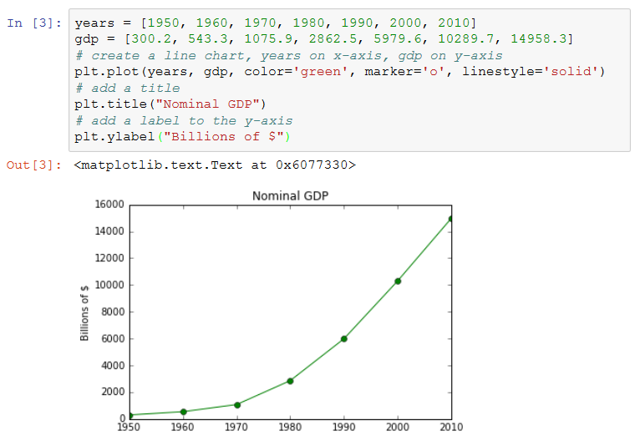
Plotting Figure by Points
Let’s consider a real life example:
The figure is created by two lists of values:
years and gdp

Slide 9
Plotting Figure by Standard Functions
Instead of lists of points, we may use some standard functions to plot our figures.
Let’s draw the cosine and sine functions on the same plot:
>>> X = np.linspace(-np.pi, np.pi, 256, endpoint=True)
>>> C, S = np.cos(X), np.sin(X)
>>> plt.plot(X, C)
[<matplotlib.lines.Line2D object at 0x081EC370>]
>>> plt.plot(X, S)
[<matplotlib.lines.Line2D object at 0x081EC8B0>]
>>> plt.show()

Slide 10
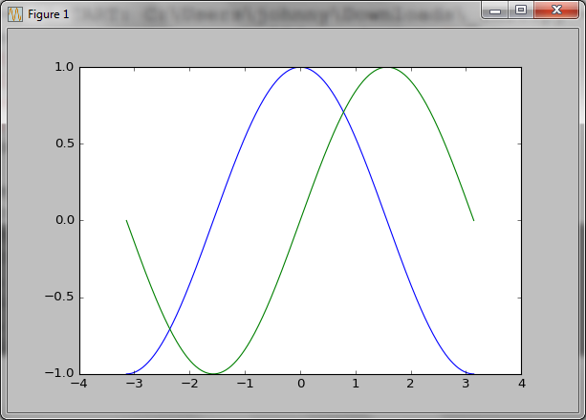
Plotting Figure by Standard Functions (cont.)
We may save our figure in a file:
>>> plt.savefig('plot1002.png')

Slide 11
Customizing the Plot
Let’s start to customize our plot.
We can change the axis limits using xlim() and ylim():
>>> # 100 evenly‐spaced values from 0 to 20
>>> x = np.linspace(0, 20, 100)
>>> y = np.sin(x)
>>> plt.plot(x, y)
[<matplotlib.lines.Line2D object at 0x07BD6AF0>]
>>> plt.xlim(5, 15)
(5, 15)
>>> plt.ylim(-1.2, 1.2)
(-1.2, 1.2)
>>> plt.show()

Slide 12
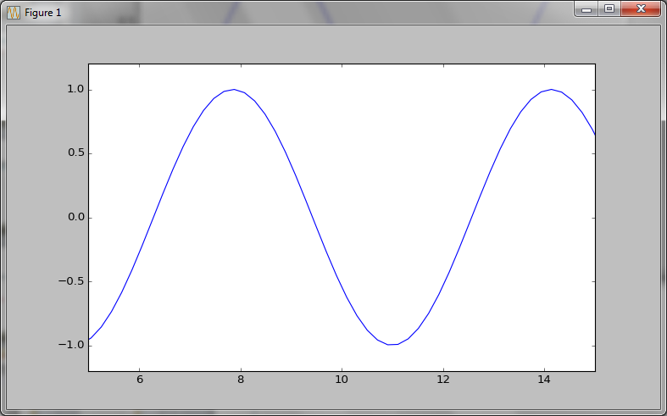
Customizing the Plot (cont.)
The output plot with axis limits set:

Slide 13
Customizing the Plot (cont.)
We can label the axes and add a title:
>>> plt.plot(x, y)
[<matplotlib.lines.Line2D object at 0x07D2F850>]
>>> plt.xlabel('This is x-axis label')
<matplotlib.text.Text object at 0x07BBB210>
>>> plt.ylabel('This is y-axis label')
<matplotlib.text.Text object at 0x07D0F750>
>>> plt.title('My Customized Plot')
<matplotlib.text.Text object at 0x07D1E8D0>
>>> plt.show()

Slide 14
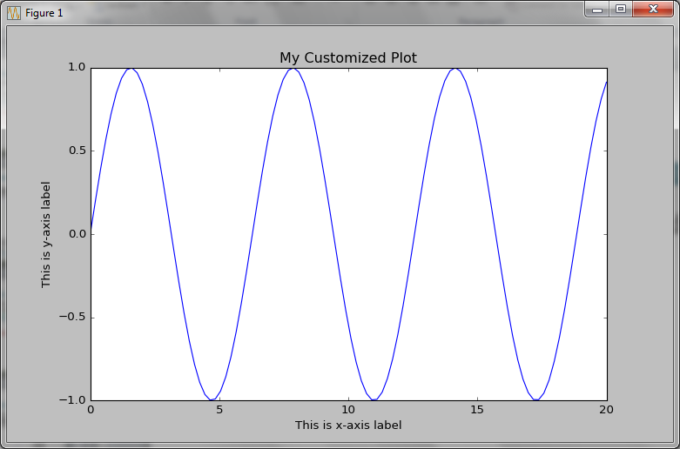
Customizing the Plot (cont.)
The output plot with title and labels added:

Slide 15
Customizing the Plot (cont.)
We can vary the line color or the line symbol:
>>> plt.plot(x, y, '-r')
[<matplotlib.lines.Line2D object at 0x07D64770>]
>>> plt.xlim(0, 10)
(0, 10)
>>> plt.ylim(-1.2, 1.2)
(-1.2, 1.2)
>>> plt.xlabel('This is x-axis label')
<matplotlib.text.Text object at 0x07D35330>
>>> plt.ylabel('This is y-axis label')
<matplotlib.text.Text object at 0x07D43630>
>>> plt.title('My Customized Plot')
<matplotlib.text.Text object at 0x07D52730>
>>> plt.show()

Slide 16
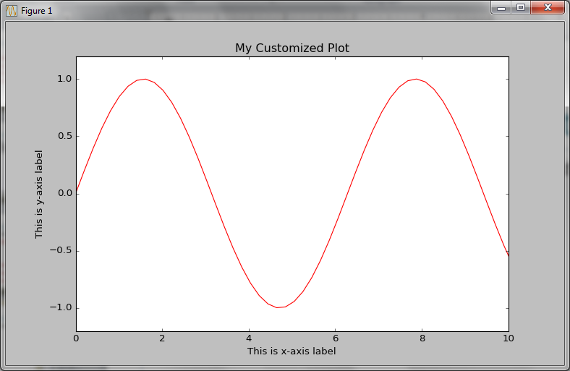
Customizing the Plot (cont.)
The output plot with line color and line style set:

Slide 17
Customizing the Plot (cont.)
Other options for the color characters are:
'r' = red
'g' = green
'b' = blue
'c' = cyan
'm' = magenta
'y' = yellow
'k' = black
'w' = white

Slide 18
Customizing the Plot (cont.)
Options for line styles are
'‐' = solid
'‐‐' = dashed
':' = dotted
'‐.' = dot‐dashed
'.' = points
'o' = filled circles
'^' = filled triangles
and many, many more.

Slide 19
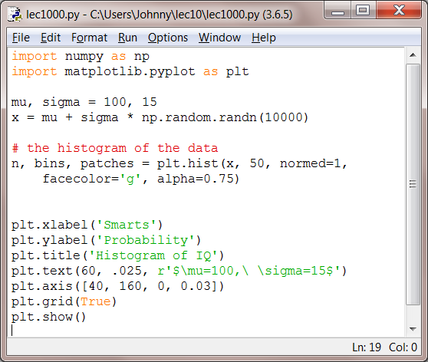
Customizing the Plot (cont.)
We can also add text in an arbitrary location using text() command:
Script ‘lec1000.py’
hist() function will be introduced later in this lesson.

Slide 20
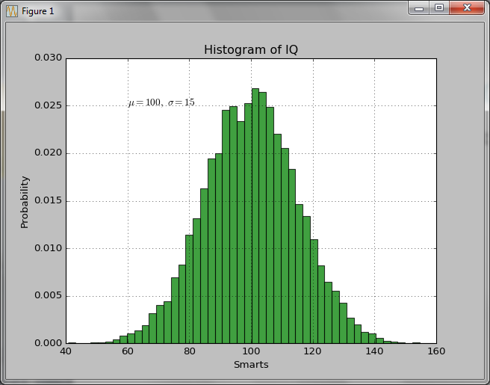
Customizing the Plot (cont.)
The figure with some text added is:

Slide 21
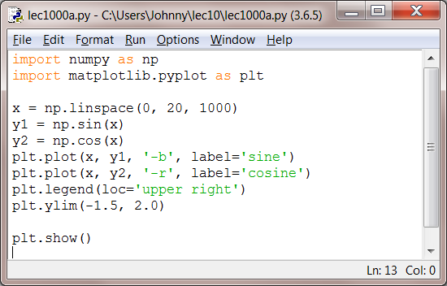
Customizing the Plot (cont.)
Multiple lines can be shown on the same plot. In this case, you can use a legend to label the two lines:

Slide 22
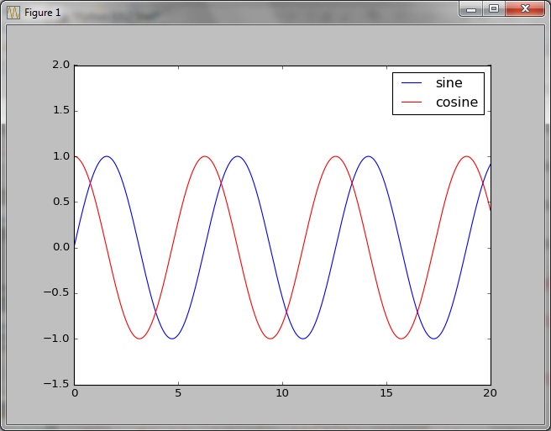
Customizing the Plot (cont.)
The plot with a legend added is shown:

Slide 23
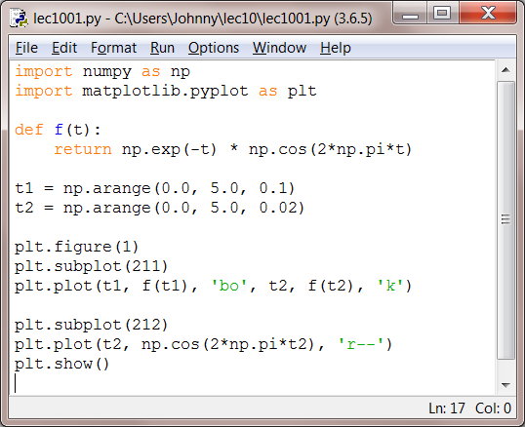
Working with Multiple Figures
The following script creates two subplots on one figure:
Script ‘lec1001.py’

Slide 24
Working with Multiple Figures
The figure() command from previous script is optional because figure(1) will be created by default.
subplot(111) will also be created by default.
The subplot() command specifies numrows, numcols, fignum where fignum ranges from 1 to numrows*numcols.
The commas in the subplot command are optional if numrows*numcols < 10.
So subplot(211) is identical to subplot(2,1,1).

Slide 25
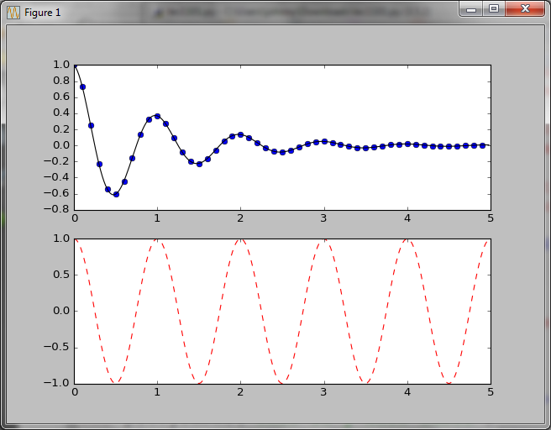
Working with Multiple Figures (cont.)
The resulting subplots are:

Slide 26
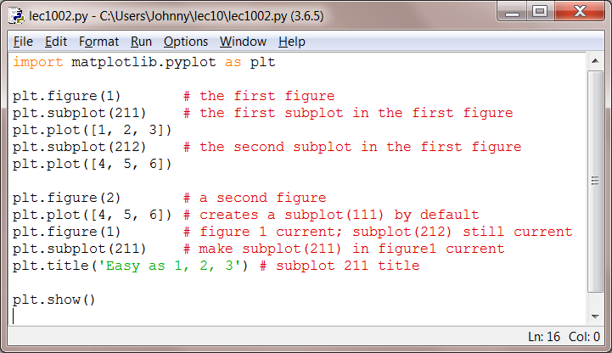
Working with Multiple Figures (cont.)
The following script (lec1002.py) creates two figure:

Slide 27
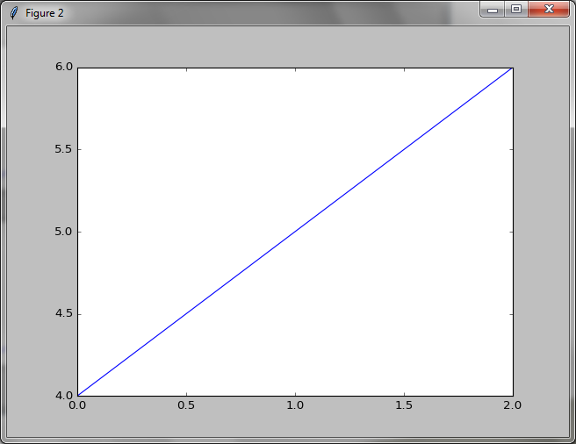
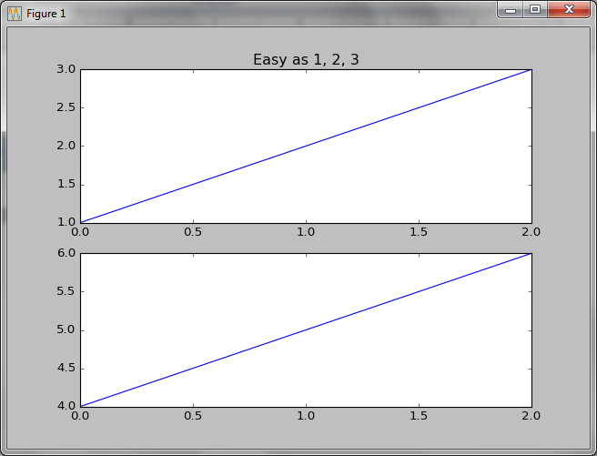
Working with Multiple Figures (cont.)
The resulting figures are:

Slide 28
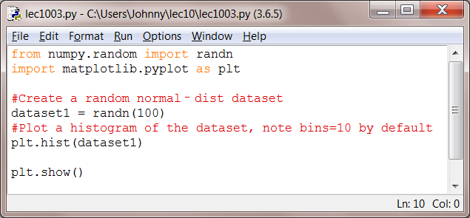
Working with Other 2D Figures
Histogram
The figures we have learned so far are called line charts or line plots.
Now we will look at some other types 2D figures, including histograms, bar charts, and scatterplots.
Let’s consider a histogram first:
Bins are the intervals of the dataset (x-axis).

Slide 29
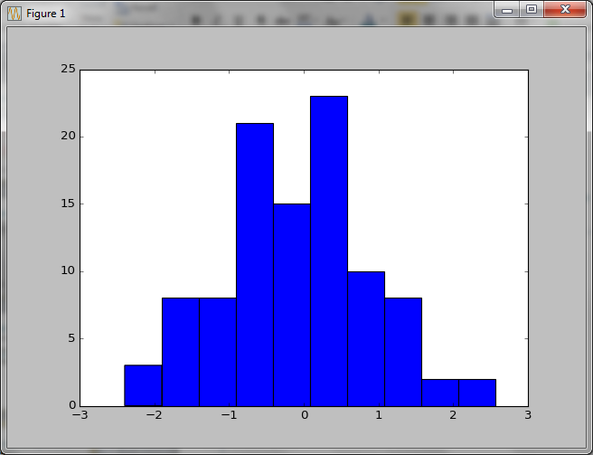
Working with Other 2D Figures (cont.)
Histogram
The resulting histogram is:
A histogram is a graphical representation of the distribution of numerical data.
It gives a discretized display of value frequency.
The data points are split into discrete, evenly spaced bins, and the number of data points in each bin is plotted.

Slide 30
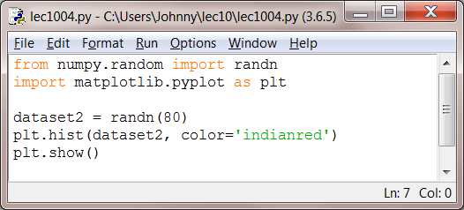
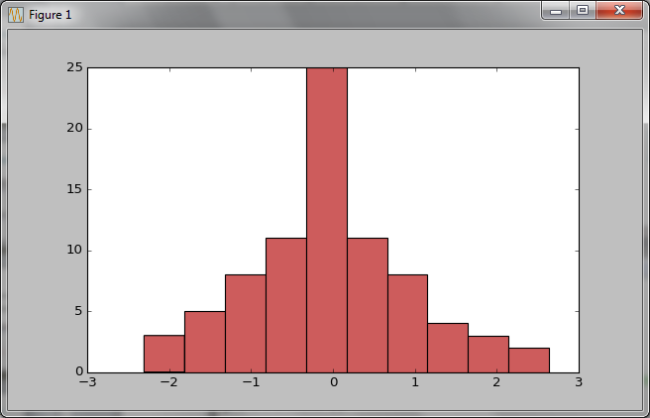
Working with Other 2D Figures (cont.)
Histogram
Another histogram:

Slide 31
Working with Other 2D Figures (cont.)
Bar Chart
Let’s look at how to plot bar charts.
A bar chart is a good choice when you want to show how some quantity varies among some discrete set items (categories).
>>> movies = ["Annie Hall", "Ben-Hur", "Casablanca", "Gandhi", "West Side Story"]
>>> num_oscars = [5, 11, 3, 8, 10]
>>> xs = [i + 0.1 for i, _ in enumerate(movies)]
>>> xs
[0.1, 1.1, 2.1, 3.1, 4.1]
>>> plt.bar(xs, num_oscars)
>>> plt.ylabel("# of Academy Awards")
>>> plt.title("My Favorite Movies")
>>> plt.xticks([i + 0.5 for i, _ in enumerate(movies)], movies)
>>> plt.show()

Slide 32
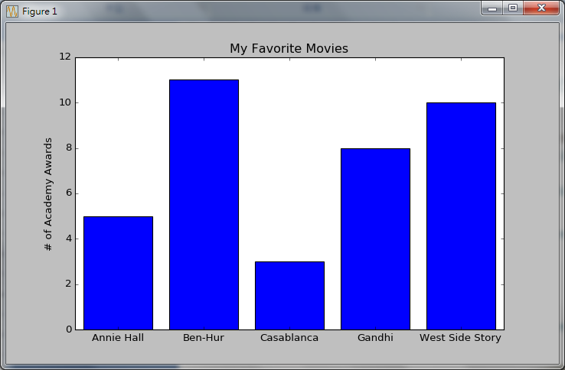
Working with Other 2D Figures (cont.)
Bar Chart
The resulting bar chart:

Slide 33
Working with Other 2D Figures (cont.)
Bar Chart
pandas also provides plotting functions.
Here we use pandas to draw a bar chart.
First we create a data set in form of a DataFrame:
>>> df = DataFrame(np.random.rand(6, 4),
index=['one', 'two', 'three', 'four', 'five', 'six'],
columns=pd.Index(['A', 'B', 'C', 'D'], name='Genus'))
>>> df
Genus A B C D
one 0.929616 0.316376 0.183919 0.204560
two 0.567725 0.595545 0.964515 0.653177
three 0.748907 0.653570 0.747715 0.961307
four 0.008388 0.106444 0.298704 0.656411
five 0.809813 0.872176 0.964648 0.723685
six 0.642475 0.717454 0.467599 0.325585

Slide 34
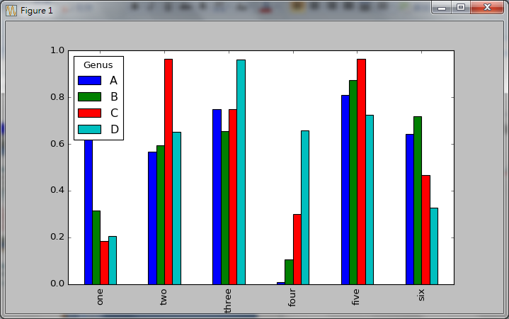
Working with Other 2D Figures (cont.)
Bar Chart
Now we use the data set df to plot a bar chart:
>>> df.plot(kind='bar')
>>> plt.show()

Slide 35
Working with Other 2D Figures (cont.)
Scatterplot
The last type of figures to be discussed is scatterplot.
A scatterplot is the right choice for visualizing the relationship between two paired sets of data.
Here we will illustrate the relationship between the number of friends your users have and the number of minutes they spend on the site every day:
>>> friends = [70, 65, 72, 63, 71, 64, 60, 64, 67]
>>> minutes = [175, 170, 205, 120, 220, 130, 105, 145, 190]
>>> plt.scatter(friends, minutes)
>>> plt.show()

Slide 36
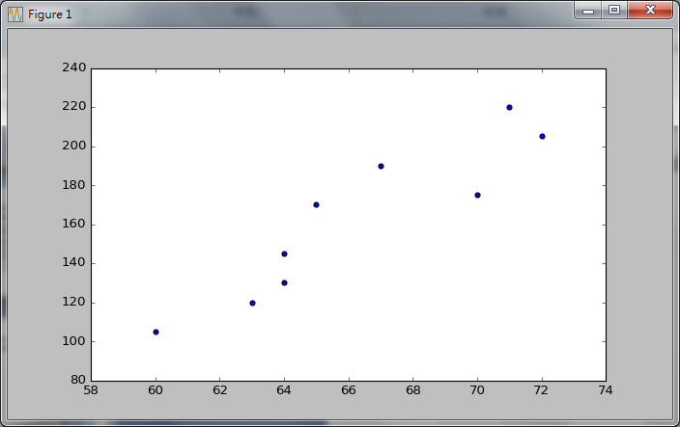
Working with Other 2D Figures (cont.)
Scatterplot
The scatterplot seems to show a rough positive relationship between friends (x-axis) and minutes (y-axis):

Slide 37
3D Plots
Optional
Getting Started
3D Line Plots
3D Scatter Plots
Surface Plots
3D Bar Plots
2D Pots in 3D

Slide 38
Getting Started
The matplotlib mplot3d toolkit adds simple 3D plotting capabilities to matplotlib by supplying an axes object that can create a 2D projection of a 3D scene.
An Axes3D object is created just like any other axes using the projection=‘3d’ keyword.
Create a new matplotlib.figure.Figure and add a new axes to it of type Axes3D:
import matplotlib.pyplot as plt
from mpl_toolkits.mplot3d import Axes3D
fig = plt.figure()
ax = fig.add_subplot(111, projection='3d')

Slide 39
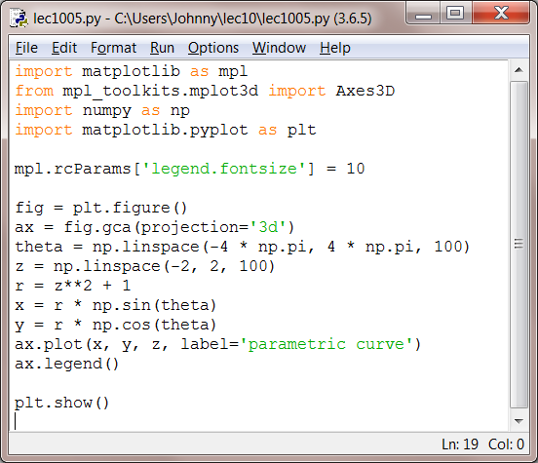
3D Line Plots
Consider the example of a 3D line plot:
Script ‘lec1005.py’

Slide 40
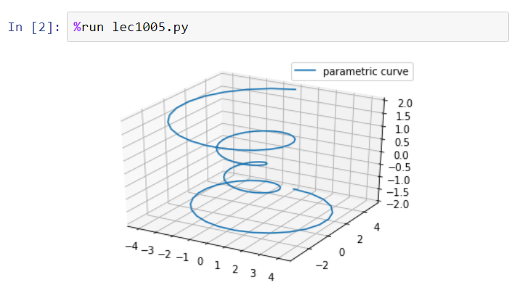
3D Line Plots (cont.)

Slide 41
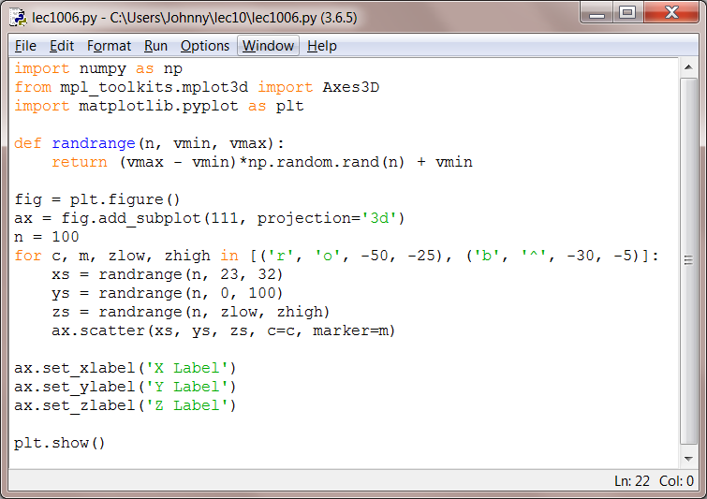
3D Scatter Plots
Here is a 3D scatter plot example:
Script ‘lec1006.py’

Slide 42
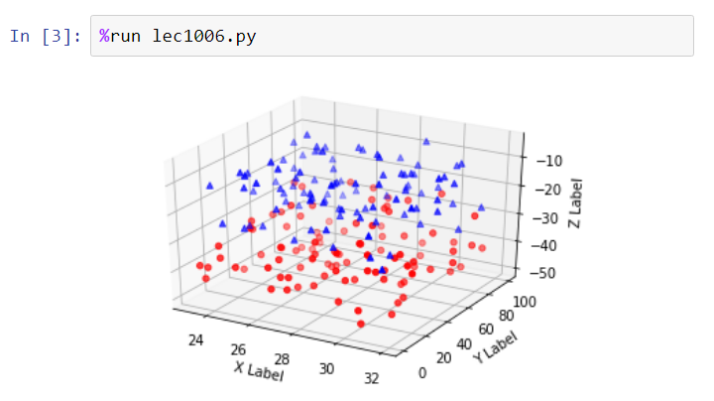
3D Scatter Plots (cont.)

Slide 43
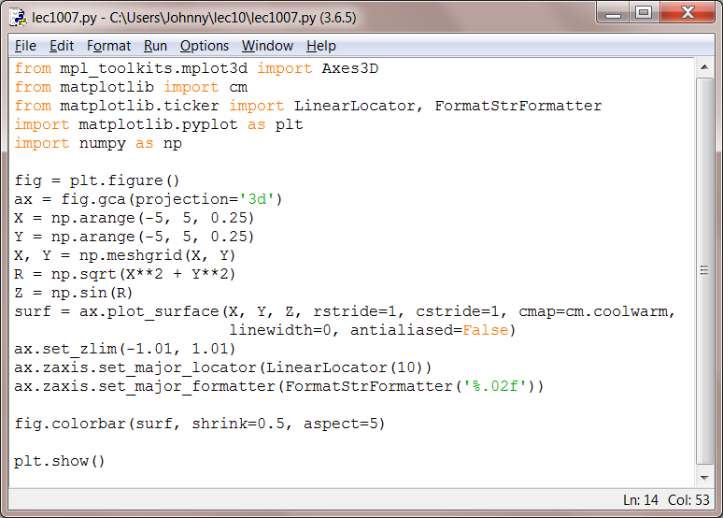
Surface Plots
Let’s see a surface plot example:
Script ‘lec1007.py’

Slide 44
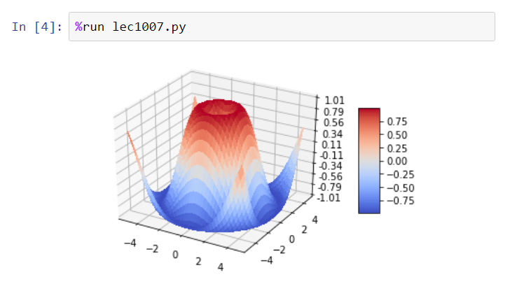
Surface Plots (cont.)

Slide 45
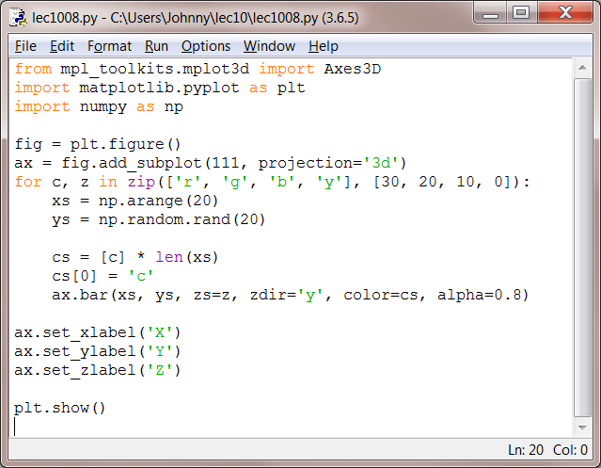
3D Bar Plots
Here we have a 3D bar plot example:
Script ‘lec1008.py’

Slide 46
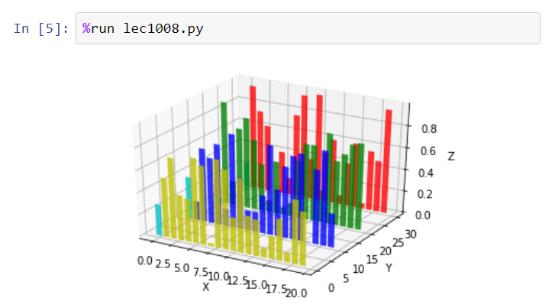
3D Bar Plots (cont.)

Slide 47
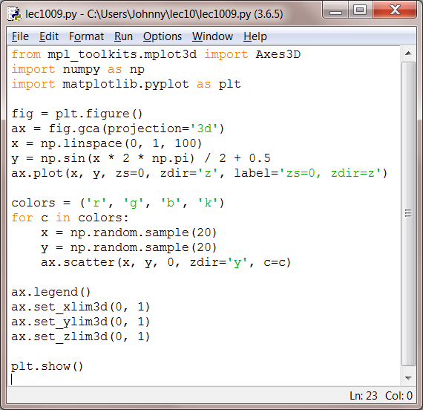
2D Plots in 3D
The example illustrates a 2D plot on a 3D plot:
Script ‘lec1009.py’

Slide 48
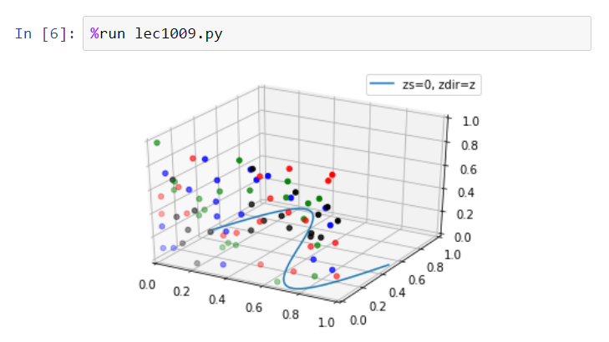
2D Plots in 3D (cont.)

Slide 49
Self Study Guide

Slide 50
Self Study Guide:
References
Ivan Idris (2014). Python Data Analysis, Packt Publishing. (Read Ch. 6)
Joel Grus (2015). Data Science from Scratch, O’Reilly. (Read Ch. 3)
Wes McKinney (2012). Python for Data Analysis, O’Reilly. (Read Ch. 8)
Online Resources:
http://matplotlib.org/
http://matplotlib.org/users/beginner.html
http://www.labri.fr/perso/nrougier/teaching/matplotlib/

